Slide 1
Austin Phillips/Desiree Sprayberry
Job Shadowing Experience

Slide 2
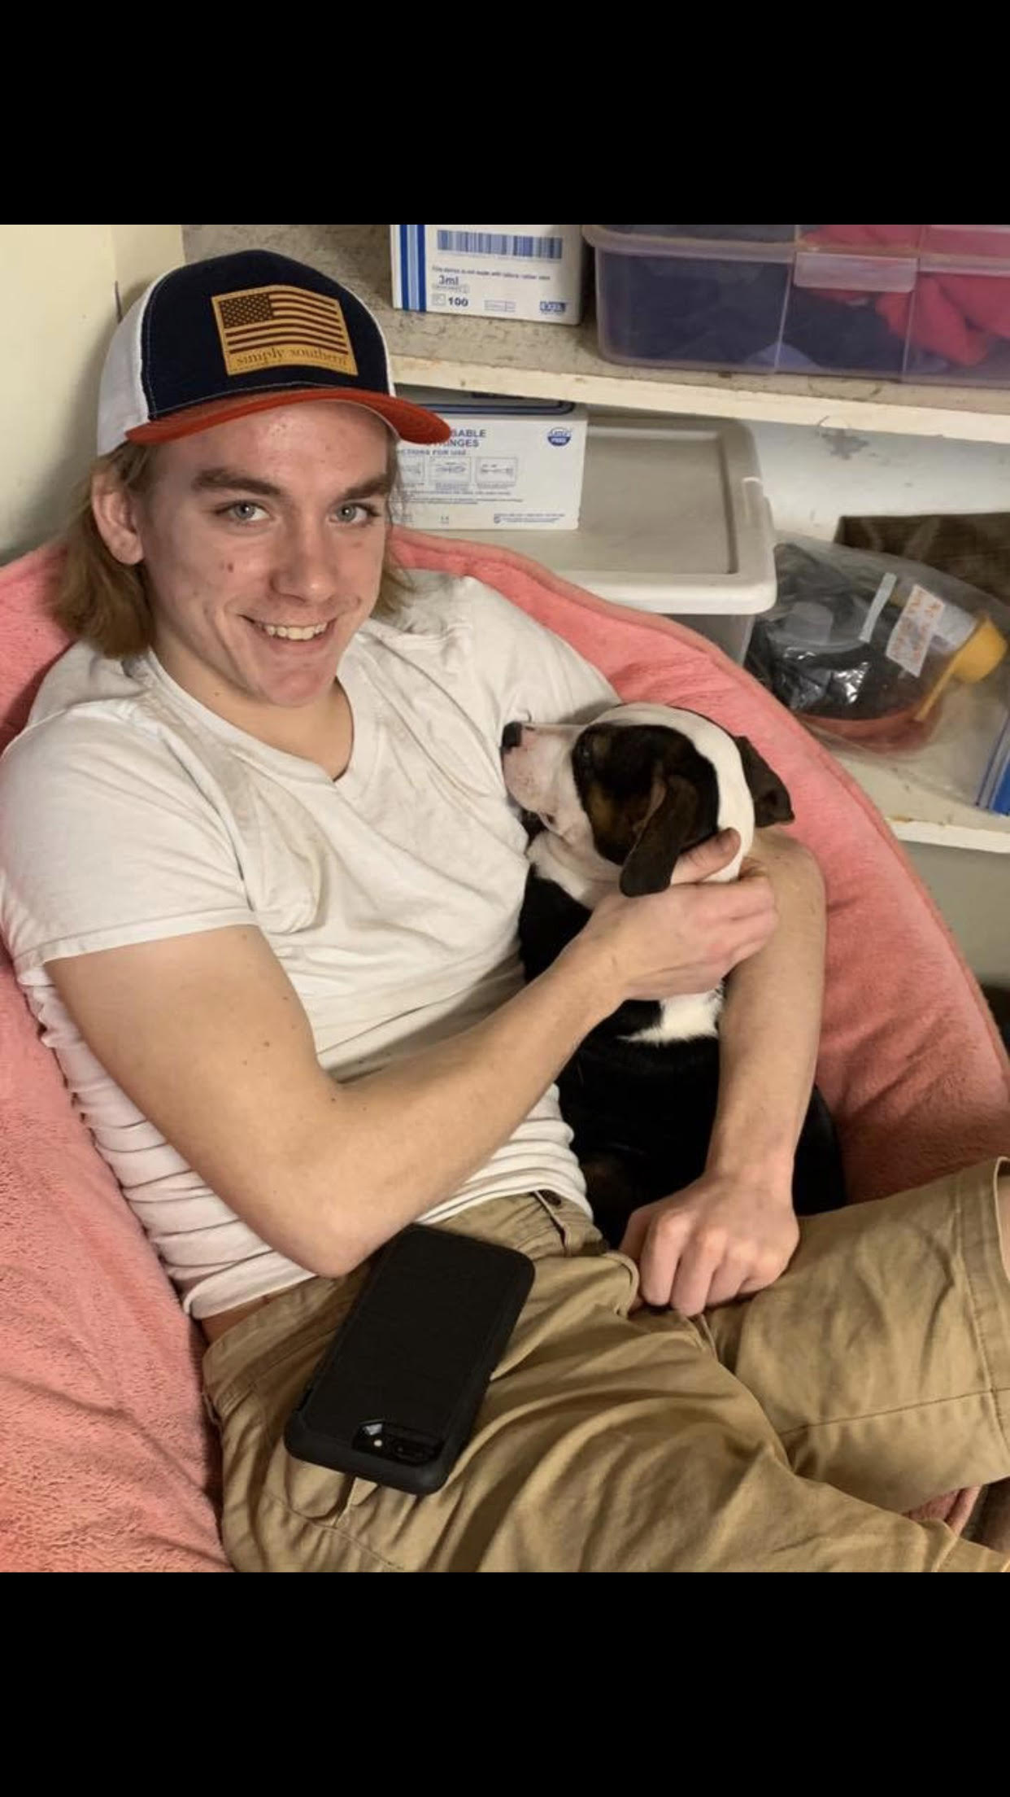
Dolly Goodpuppy
The location of this job shadowing experience/ volunteering is in
Barnesville, Georgia. I do not know the exact address. I volunteer at Dolly Good Puppy. I go every single Saturday/Sunday. I volunteer 3-4 hours every Saturday or Sunday. Austin and I go and do many things. When we first get there we like to say Hey to all of the dogs. Then we like to walk some of them that loved to be walked. Then we snuggles with all our little dog friends whom we love endlessly. Their like our best friends but in dog form. We love to go and make a difference in their sweet little lives. They are all so happy and friendly. They love all the company and attention they can get.

Slide 3
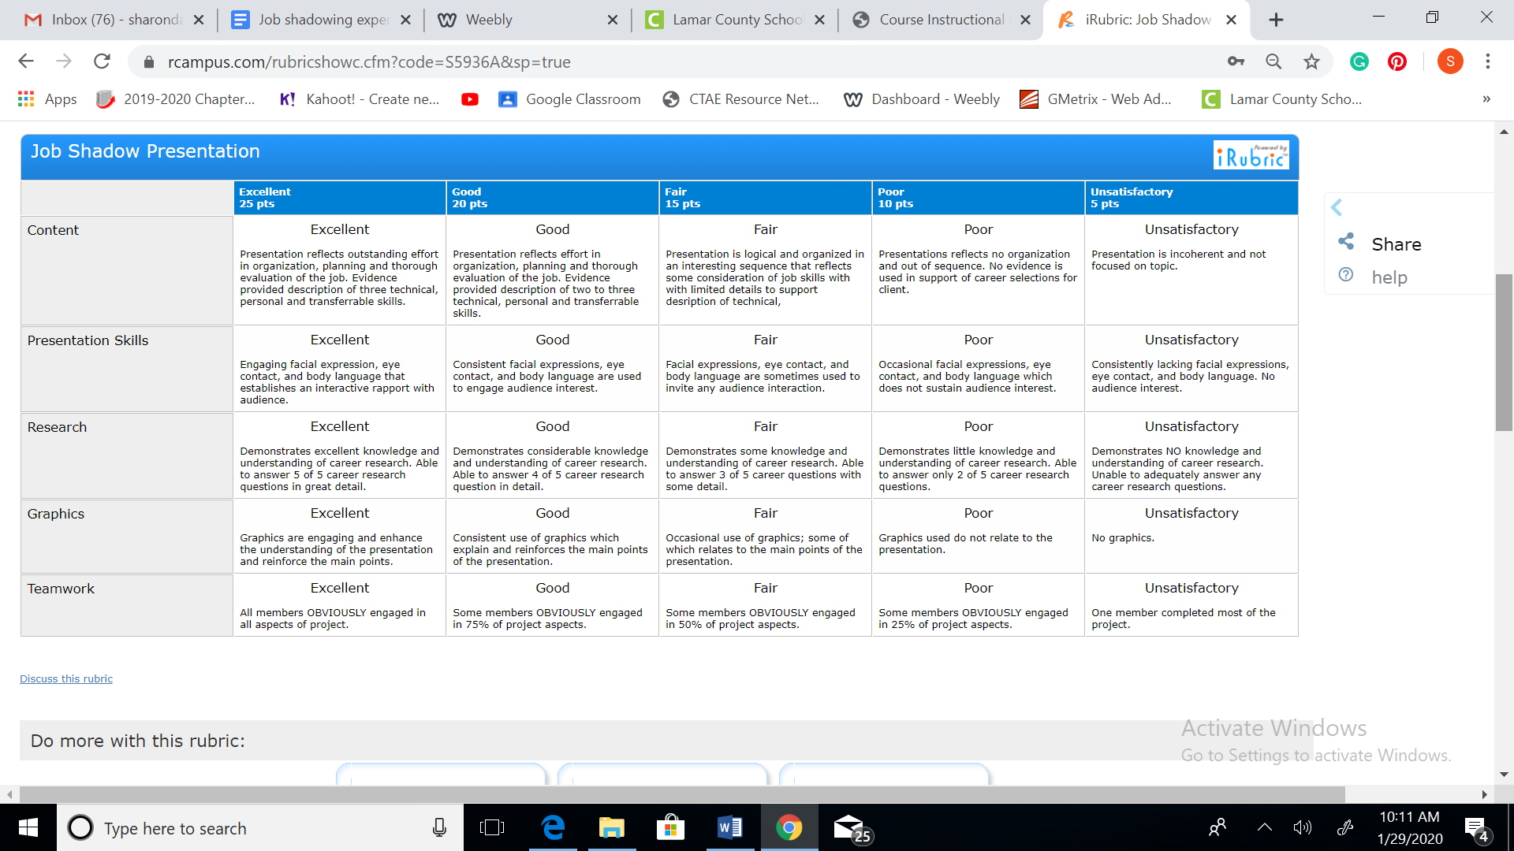
Comments: Engaging presentation and held student attention. Very enthuasiatic and has made has this experience part of your weekly plans and is listed on your phone calendar.

Slide 4
Job Shadowing Lesson Plan BMT-BC-8 Communications in the Workplace
Description of Activity: Introduce students to the concept of job shadowing where they will “shadow” an adult at his or her job for part or all of a work day. The job shadow will let them see a sample career in action and visit a real workplace.
Coach the students on the questions they should ask during the job shadow day
Students should write a summary of their shadowing experience.
Evaluation: Students will participate in a job shadow experience, interview the hosts, and reflect on their experience.
http://www.fldoe.org/core/fileparse.php/7531/urlt/job-shadowing.pdf

